Slide 1
VXX Options pricing
Black-Scholes vs Deep Learning

Slide 2
Introduction
Options are financial derivative contracts that give buyers the right to buy or sell a security at a predetermined price on or before a specified date
Options are used by traders to hedge against and speculate on future price changes of an underlying security
The accurate valuation of options is crucial in managing financial risk when hedging or speculating thus there is a substantial amount of research on the subject
This project explores options pricing via…

Slide 3
Option valuation models
Early valuation models suffer from various assumptions about financial markets and individual securities that limit their practical efficacy
Enabled by improvements in data availability and computing power, machine learning models that avoid many of these assumptions have been shown to improve performance in practice
Artificial neural networks (ANNs) are one type of machine (deep) learning model that do not require assumptions and are considered universal function approximators given their ability to represent a wide variety of arbitrary functions
These features allow ANNs to generalize well and make them a good choice for pricing options

Slide 4
Project
Goal: Compare the performance of the seminal Black-Scholes (BS) model to the performance of a multi-layer perceptron (MLP) deep learning model in pricing VXX options. Replicating the results of ¹Option Pricing with Deep Learning in accordance with ²Pricing options and computing implied volatilities using neural networks
Data:
VXX Options - 3,147,375 observations from 2010 to 2019 - STRIKE PRICE & TIME TO MATURITY
VXX Securities - from 2010 to 2019 corresponding with the options - UNDERLYING SECURITY PRICE & IMPLIED VOLATILITY
³Treasury Yields Data – from 2010 to 2019 corresponding with the options – RISK FREE RATE
* The iPath S&P 500 VIX Short-Term Futures ETN (VXX) was an ETN and thus traded like an ETF until its ultimate expiration on Jan. 31, 2019. Over its life the VXX was primarily used to speculate on and hedge against market volatility as tracked by the VIX
Method:
BS - simple to implement and measure performance with the given formula
MLP - multi-layer perceptron model with inputs identical to the BS model so that performance can be directly compared. Hyperparameters will initially be set in accordance with the two model papers where appropriate.

Slide 5
Black-Scholes Formula
Call Option Price
C = S· Φ(d₁) - Xe^{-rt} · Φ(d₂)
Put Option Price
P = Xe^{-r·t} [1 - Φ(d2)] - S [1- Φ(d₁)]
Note:
d₁ = [ln(S/X) + (r + σ²/2)t] / σ√t
d₂ = d₁ - σ√t
Φ = cumulative density function of the normal distribution
Notable assumptions:
Option can only be exercised at expiration (European)
No dividends are paid out over the life of the option
Efficient markets (no arbitrage)
Known & constant risk-free rate and volatility
Returns of underlying asset are log-normally distributed (prices follow a random walk with constant drift and volatility)
Model Inputs:
S = Underlying security price
σ = Underlying security implied volatility
X = Option strike price
r = Risk-free rate
t = Time to expiration (years)

Slide 6
Multi-Layer Perceptron Model
Notable Assumptions:
Underlying security implied volatility
Model Inputs
Underlying security price
Underlying security implied volatility
Option strike price
Risk-free rate
Time to expiration (years)
Model Outputs
Bid Price
Ask Price
Hyperparameters:
5 input nodes for each model input
3 hidden layers with 400 nodes each
Batch Normalization
Leaky ReLu
Two output nodes for bid and ask price
ReLu
Batch Size: 1024
Epochs: 250
Optimizer: Adam

Slide 7
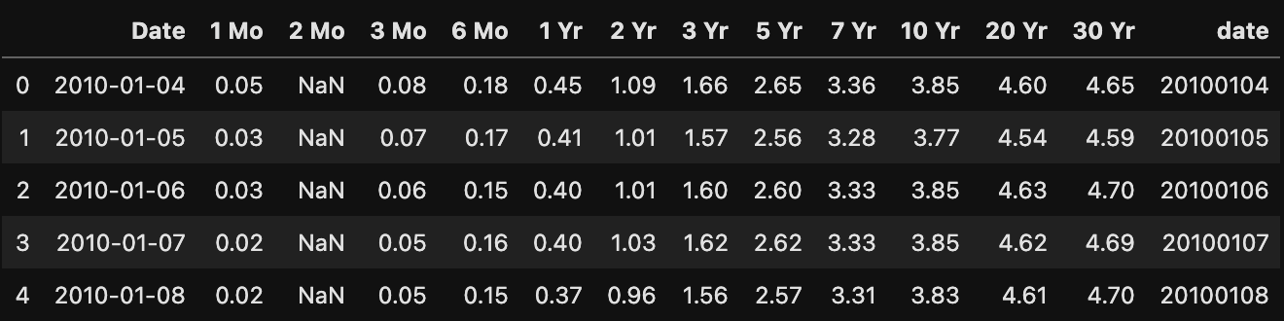
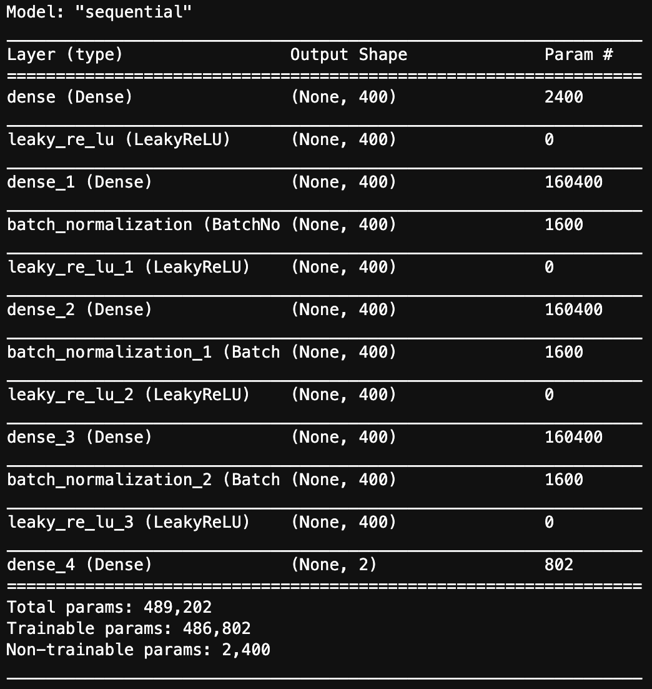
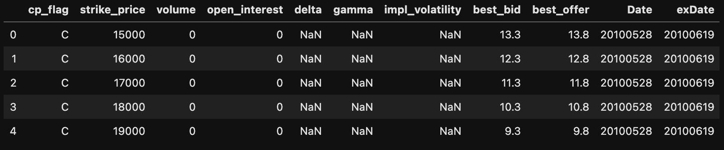
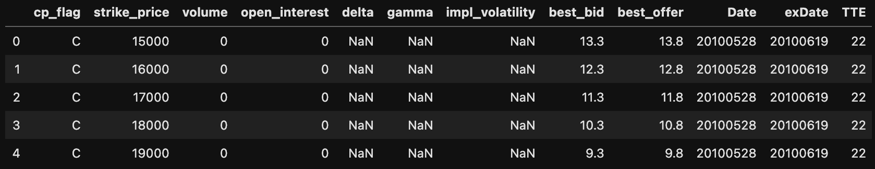
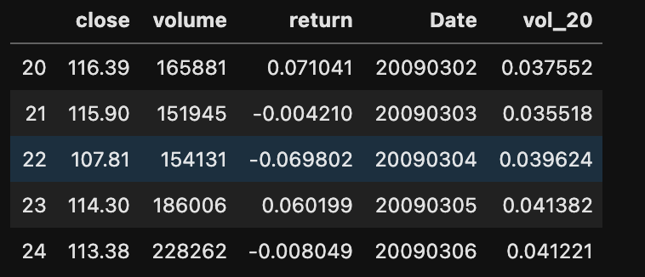
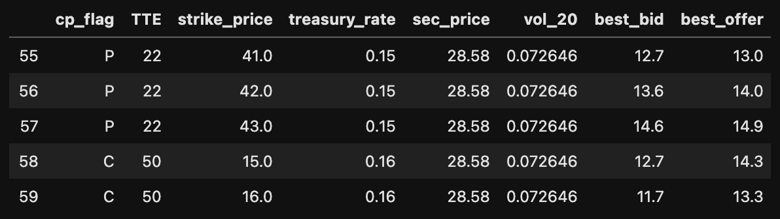
Process
Treasury Pre-Processing
Options Pre-Processing
Options Feature Engineering
Securities Feature Engineering
Data Integration and Reduction
Model Building

Slide 8
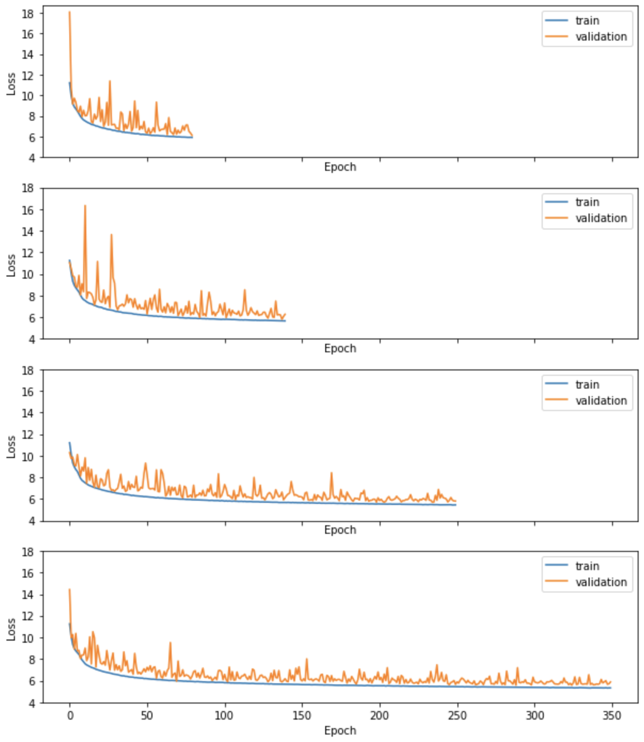
Results & Analysis - Train
Loss | 80 | 140 | 250 | 350
1 | 5.93
2 | 5.93 | 5.68
3 | 5.95 | 5.68 | 5.46
4 | 5.94 | 5.67 | 5.45 | 5.33
1
2
3
Validation Loss | 80 | 140 | 250 | 350
1 | 6.64
2 | 6.71 | 6.13
3 | 6.40 | 6.23 | 5.90
4 | 6.40 | 6.19 | 5.80 | 5.83
4
*plots created using ³Matplotlib

Slide 9
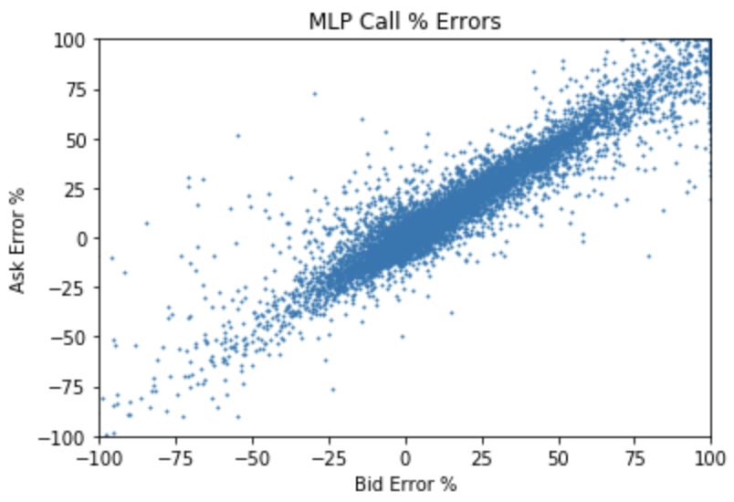
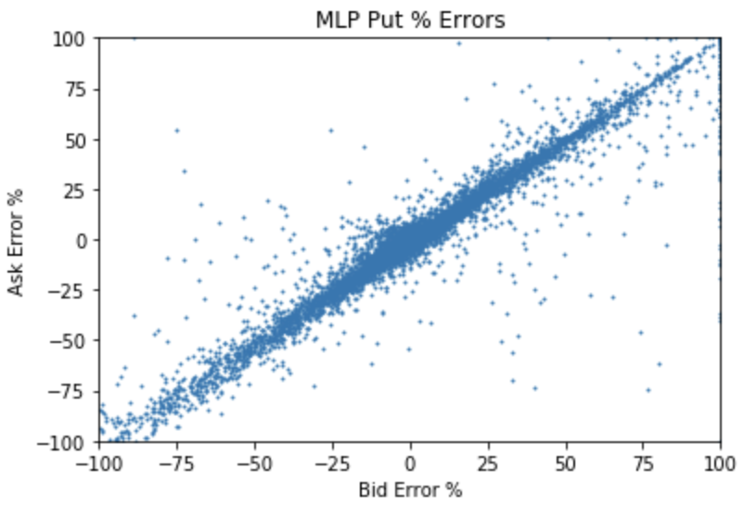
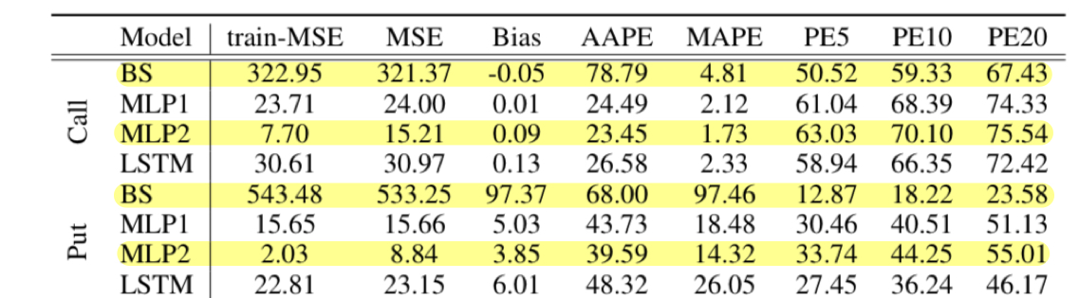
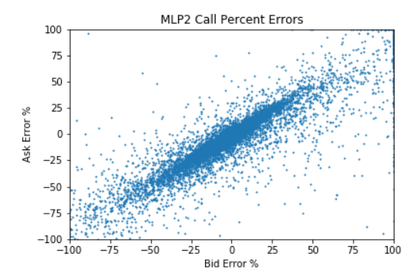
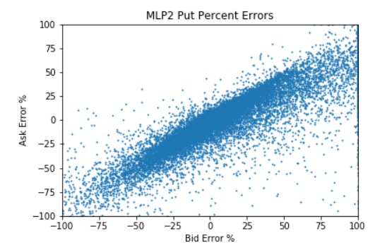
Results & Analysis - Test
 | MSE | BIAS | AAPE | MAPE | PE5 | PE10 | PE20
MLP | 5.14 | 16.98 | 863.24 | 29.58 | 16.62 | 28.60 | 42.37
BS | 36.65 | 100 | 2517.93 | 100 | 16.19 | 18.85 | 21.81
MLP | 10.77 | 0.69 | 1055.32 | 8.61 | 42.12 | 51.84 | 60.72
BS | 384.31 | 193.42 | 29202.97 | 427.18 | 3.61 | 4.82 | 7.23
Call
Put
* All metrics in percentages except for MSE

Slide 10
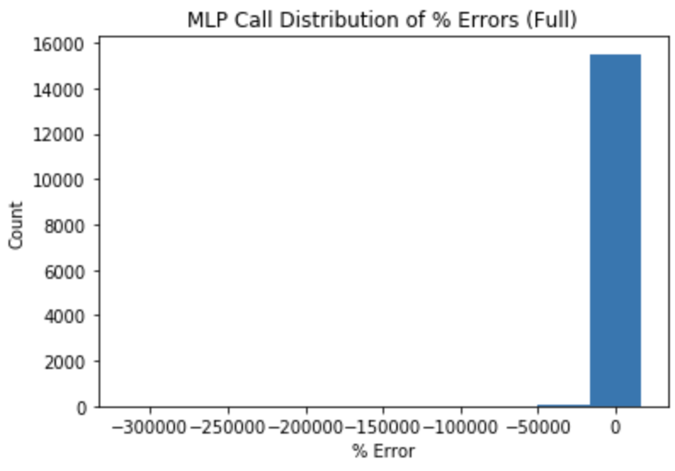
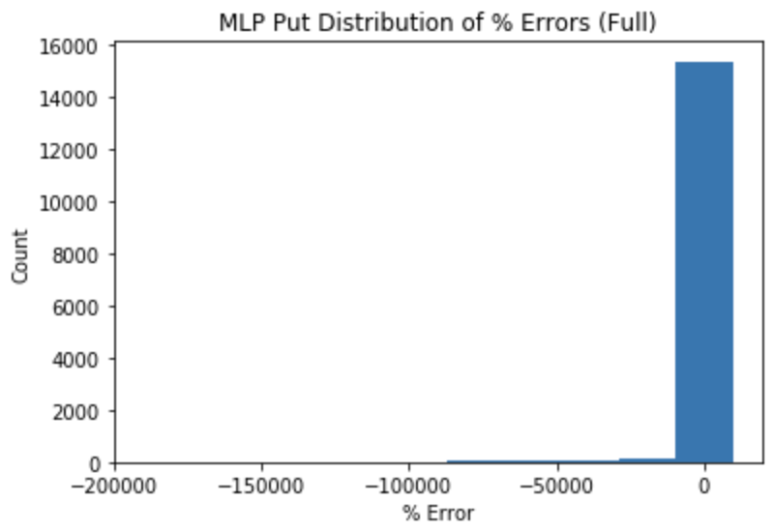
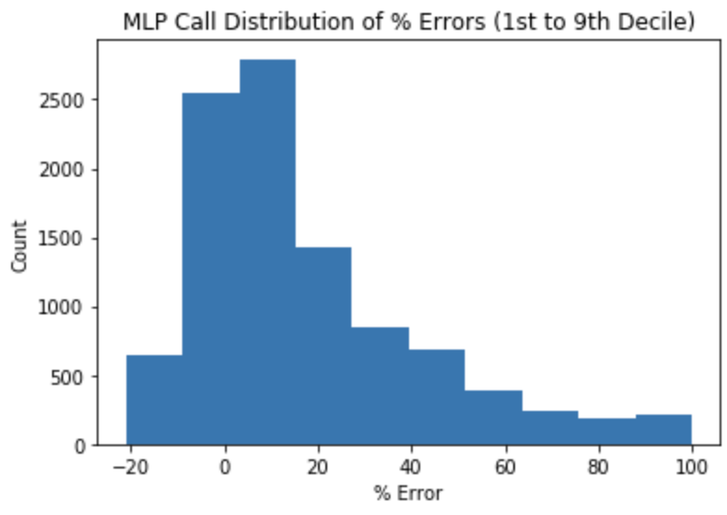
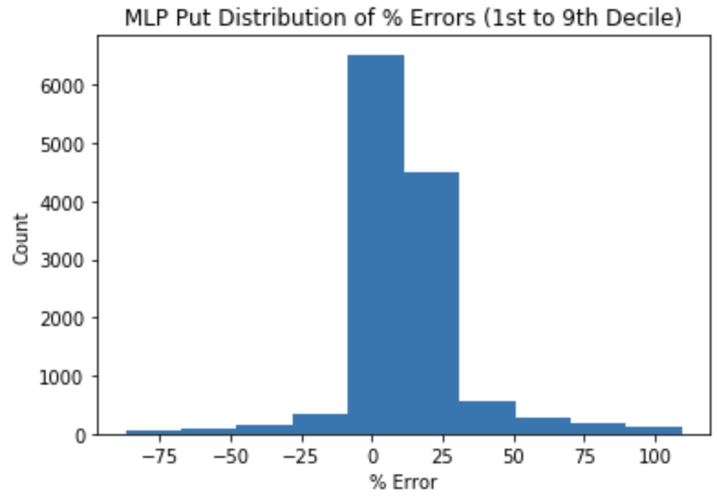
Results & Analysis - Test
 | Obs. | Min | Max | AVG | BIAS | AAPE | MAPE | PE5 | PE10 | PE20
Call | 15,604 | -333,557 | 100 | -786.88 | 16.98 | 863.24 | 29.58 | 16.62 | 28.60 | 42.37
Put | 15,604 | -193,356 | 100 | -1020.92 | 0.69 | 1055.32 | 8.61 | 42.12 | 51.84 | 60.72
Call | 9,960 | -21.04 | 99.96 | 17.31 | 9.83 | 20.31 | 11.77 | 26.03 | 44.81 | 66.39
Put | 12,251 | -97.07 | 99.74 | 0.84 | 0.59 | 13.72 | 4.22 | 53.65 | 66.03 | 77.33
Full
1st to 9th
* All metrics in percentages except for MSE

Slide 11
Conclusion
The MLP neural network models achieved performance significantly superior to the BS model when pricing VXX options given identical model inputs
The MLP neural network models tend to overestimate option prices (especially call options)
Trimming the test percent errors to exclude unusually large errors that would be dismissed in practice results in improved model performance
Model results were comparable to ¹Option Pricing with Deep Learning indicating some consistency in using MLP models to price options across different market conditions
Future work could include additional model inputs, additional hyperparameter tuning and the testing of different network architectures

Slide 12
Citations
[1] Ke, Alexander, and Andrew Yang. 2019, Option Pricing with Deep Learning,
cs230.stanford.edu/projects_fall_2019/reports/26260984.pdf.
[2] S.Liu, C.Oosterlee, and S.Bohte. Pricing options and computing implied volatilities using neural networks. Risks, 7:16, 02 2019.
[3] U.S. Department of the Treasury. Daily treasury yield curve rates.
https://www.treasury.gov/ resource-center/data-chart-center/interest-rates/pages/textview.aspx?data=yield, 2019.
[4] J.D. Hunter, “Matplotlib: A 2D Graphics Environment”, Computing in Science & Engineering, vo. 9, no. 3, pp. 90-95, 2007.
[5] Chollet, F., & others. (2015). Keras. GitHub. Retrieved from https://github.com/fchollet/keras

